Slide 1
Lesson 2
NCAE 2026
BY: TRENT GWATHNEY

Slide 2
Agenda
Overview for Week 2:
Routing Fundamentals
Mikrotik Lab
Nat Fundamentals
Port Forwarding Lab
Insecure Router GUI

Slide 3
Routing Intro
01
How does routing work?

Slide 4


How does routing work?
192.168.1.0/24
192.168.100.0/24
192.168.1.4
192.168.100.4
192.168.1.2
192.168.1.6
192.168.100.2
192.168.100.6
192.168.1.1
192.168.100.1
Transmission Link (Ethernet)

Slide 5
Routers sit on at least two networks
= Host/Person
=Router/Guide
=Router/Guide
192.168.1.0/24
192.168.100.0/24
192.168.1.4
172.31.2.0/24
192.168.100.3
192.168.1.2
192.168.1.6
192.168.100.4
192.168.100.2
192.168.1.1
172.31.2.1
172.31.2.2
192.168.100.2
LAN
WAN
LAN

Slide 6
192.168.1.0/24
192.168.30.0/24
192.168.1.4
172.31.2.0/24
192.168.30.3
192.168.1.2
192.168.1.6
192.168.30.4
192.168.30.2
192.168.1.1
172.31.2.1
172.31.2.3
192.168.100.2
LAN
LAN
192.168.10.0/24
192.168.40.0/24
192.168.10.4
192.168.40.3
192.168.10.2
192.168.10.6
172.31.2.4
192.168.40.4
192.168.10.1
WAN
172.31.2.5
192.168.100.2
192.168.40.2
LAN
LAN
192.168.20.0/24
192.168.50.0/24
192.168.20.4
192.168.50.3
192.168.20.2
192.168.20.6
192.168.50.4
192.168.50.2
192.168.20.1
172.31.2.6
172.31.2.7
192.168.50.2
LAN
LAN

Slide 7
172.31.2.1
172.31.2.2
172.31.2.3
172.31.2.4
WAN
172.31.2.5
172.31.2.6

Slide 8
Routing Fundamentals
Routing is the process of which a router delivers/forwards traffic from one network to another. Routing basics require an understanding of the following:
Public and Private IP Address
Router Interface vs Port
Routing Table Anatomy
An understanding of routing will provide an understanding of how network services are delivered

Slide 9

Public
Private
WAN
LAN
IP Addresses
The addresses assigned to reach the internet
The addresses assigned to internal devices

Slide 10
Routers sit on at least two networks
= Host/Person
=Router/Guide
=Router/Guide
192.168.1.0/24
192.168.100.0/24
192.168.1.4
172.31.2.0/24
192.168.100.3
192.168.1.2
192.168.1.6
192.168.100.4
192.168.100.2
192.168.1.1
172.31.2.1
172.31.2.2
192.168.100.2
LAN
WAN
LAN

Slide 11

Router Interface
Each port on a router can represent an interface. Each interface represents a network.

Slide 12

Interface vs Port
The Interface is the software implementation of a port. The ethernet port is the physical interface/port.

Slide 13
Microtik Lab
02
How to configure a router?

Slide 14
GitHub Demo

Slide 15
NAT Fundamentals
03
How does routing work?

Slide 16
“Why do we have public and private IP Addresses?”
—Why cant we just have public IP Addresses

Slide 17
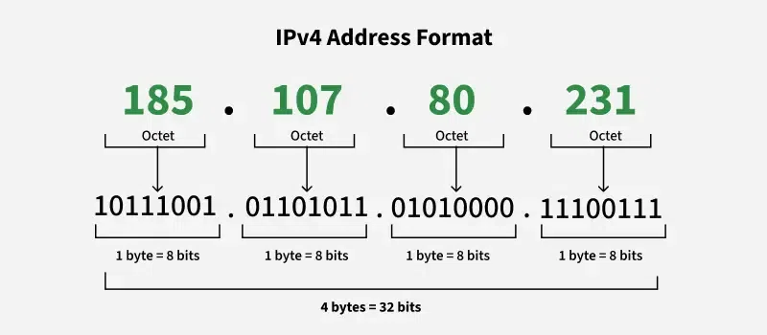

Slide 18
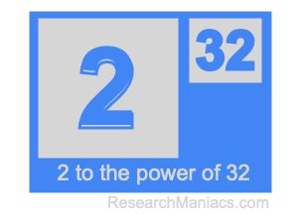

Slide 19
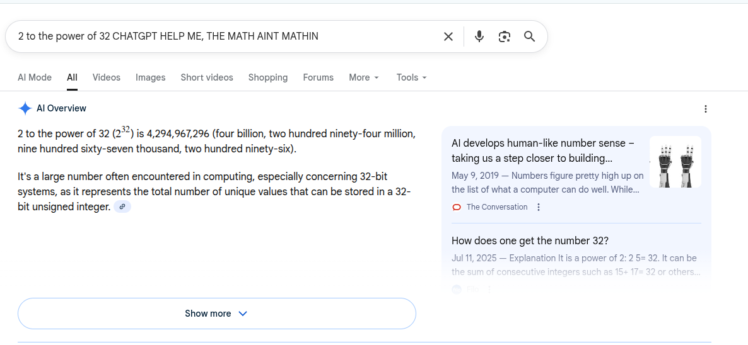

Slide 20
“Does every device need a public IP Address”
—Why cant we just have public IP Addresses

Slide 21
Network Address Translation (NAT) Explained
Network Address Translation (NAT) allows many private IPv4 devices to share a small number of public IPv4 addresses.
It solves:
IPv4 exhaustion
Internet Service Availability
It enables selected private systems to offer services to the public internet through controlled address and port translation.

Slide 22
Port Forwarding Lab
04
How to provide a LAN service to the WAN

Slide 23
PortForward
192.168.1.0/24
192.168.1.0/24
192.168.1.2:80
192.168.100.10
192.168.1.2
192.168.100.1:80
192.168.100.20
192.168.100.30

Slide 24
GitHub Demo

Slide 25
Insecure Router GUI
05
What makes default configuration vulnerable

Slide 26
Wireshark Demo

